Slide 1
metID: A R package for Automatable Compound Annotation for LC−MS-based Data
Xiaotao Shen PhD
Stanford School of Medicine
Department of Genetics
Dr. Snyder lab
November 3th, 2021 @ Philadelphia ASMS 2021
shenxt@stanford.edu
@xiaotaoshen1990
shenxt.me
github.com/jaspershen
Notes:
My topic is about decoding the links between ………

Slide 2



OUTLINE
metID: Compound Annotation for LC-MS Data
- In-house Database Construction
- Databases Provided in metID
- Database Sharing
- Case Study
TidyMass: A Computational Framework for LC-MS Data Processing and Analysis
Notes:
From the step 1 analysis, we can know that exposome has…..

Slide 3

metID: Compound Annotation for LC-MS Data

Slide 4

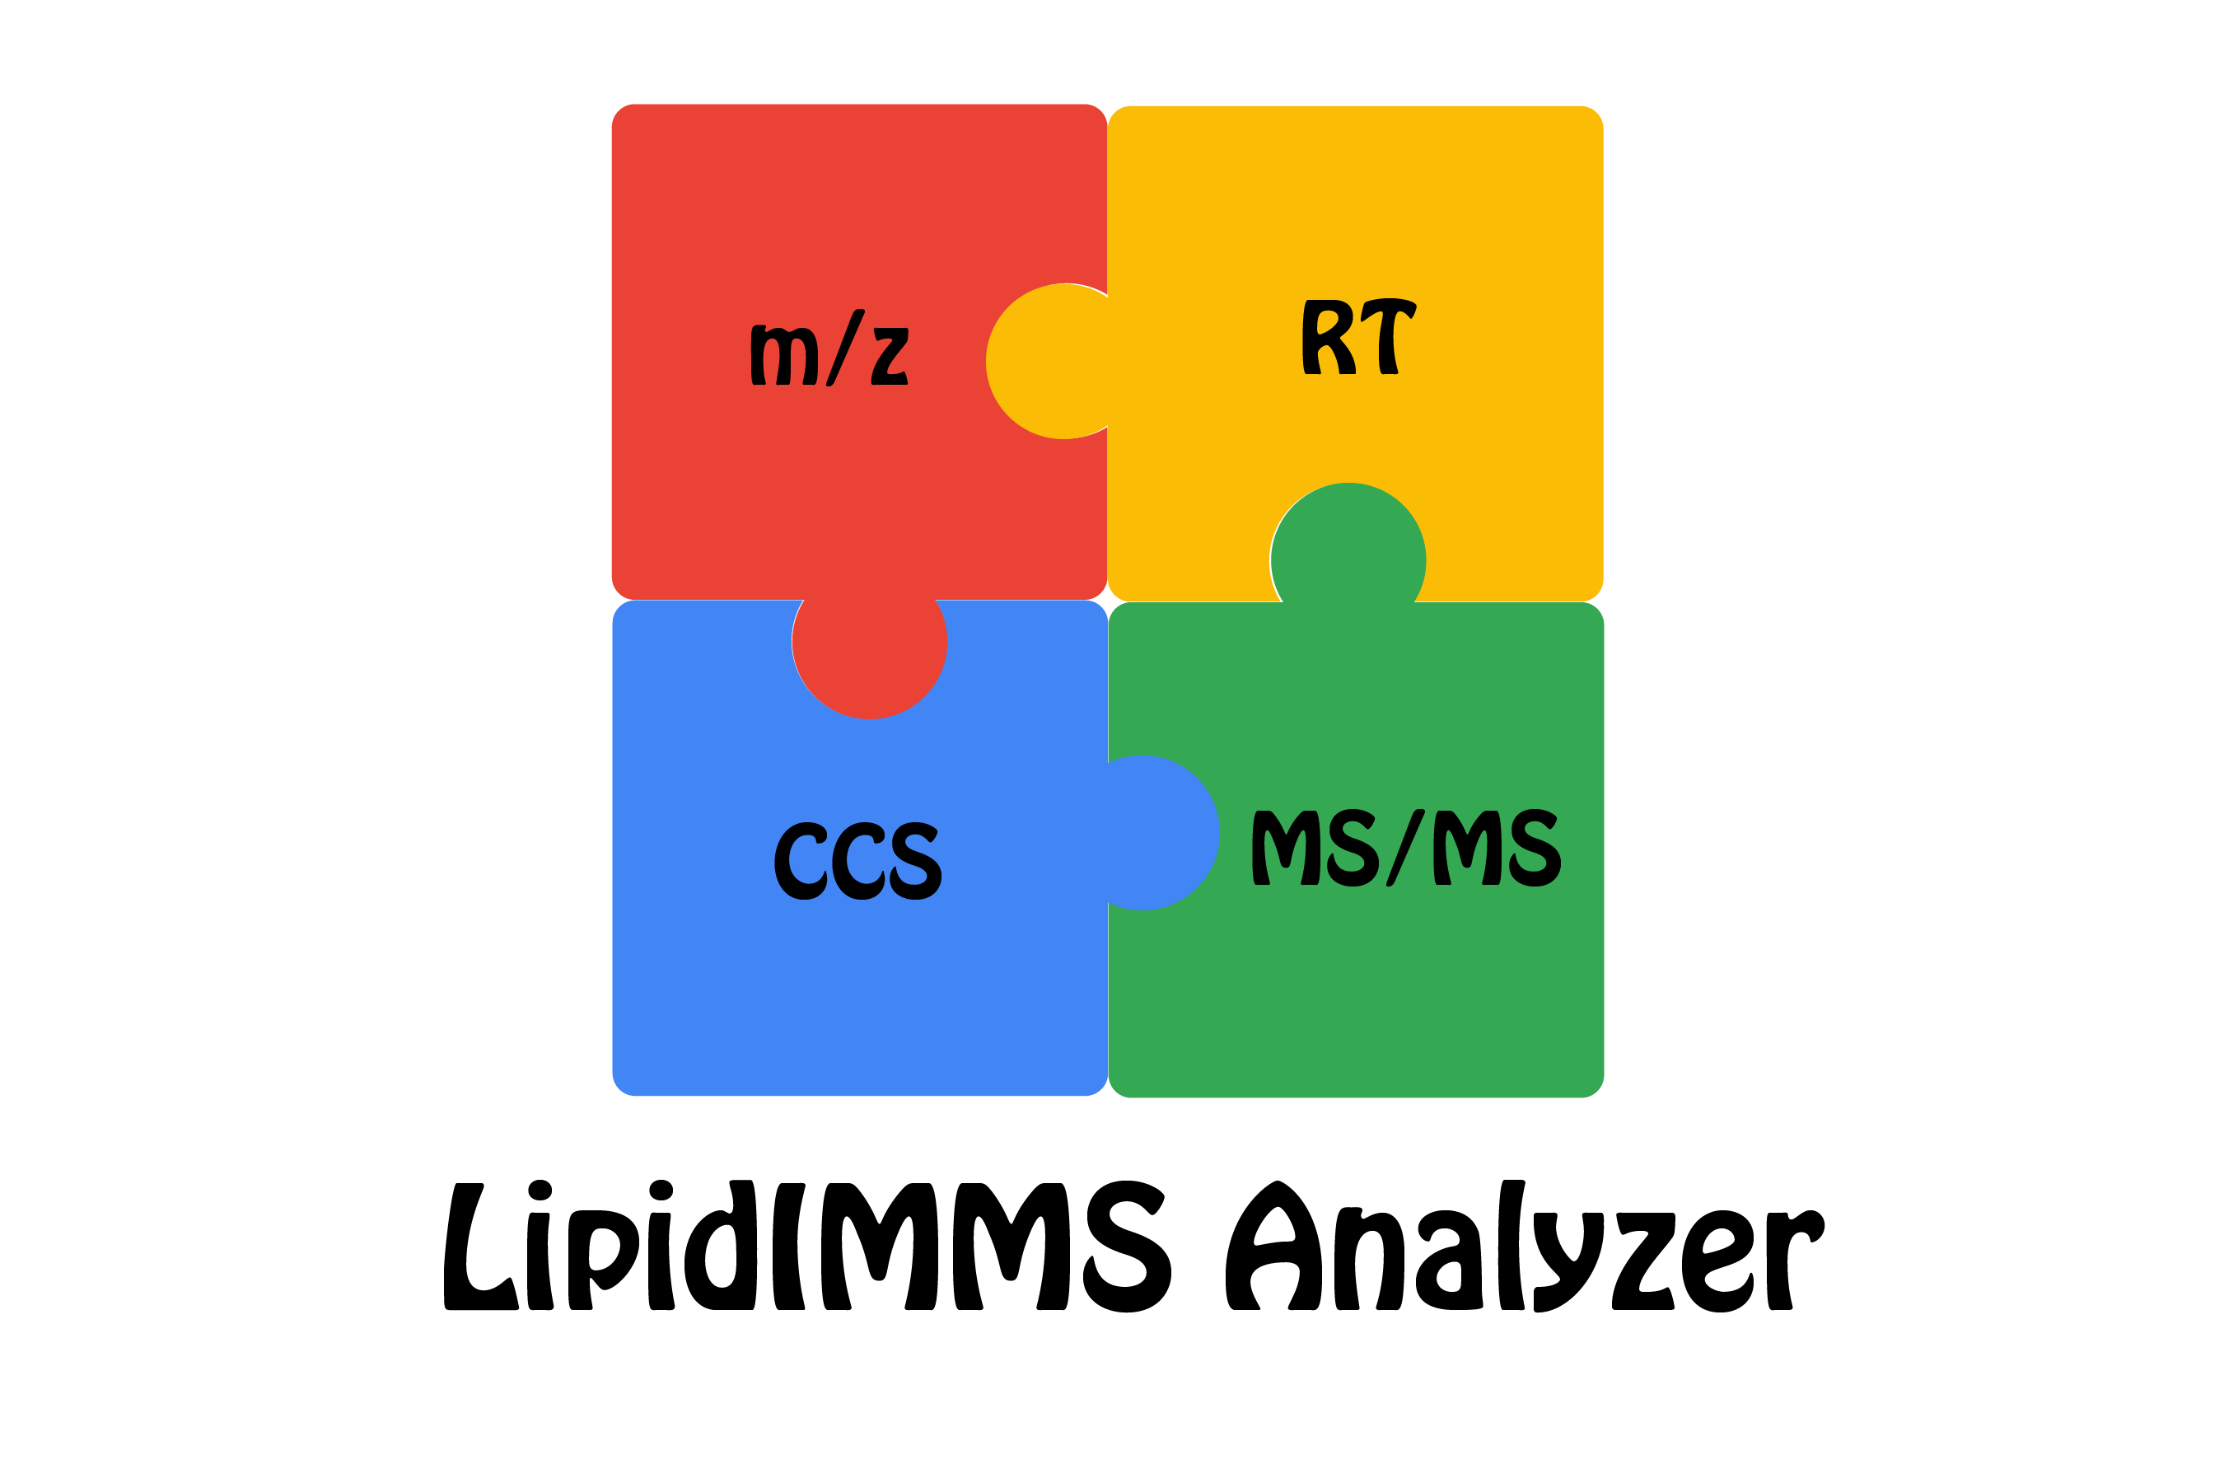




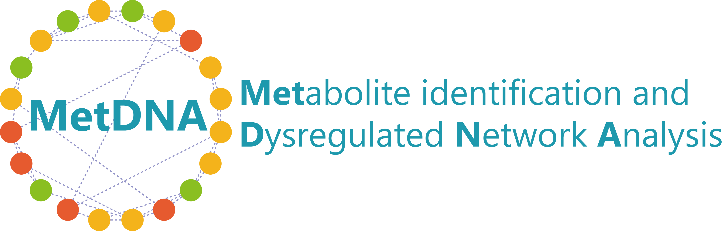


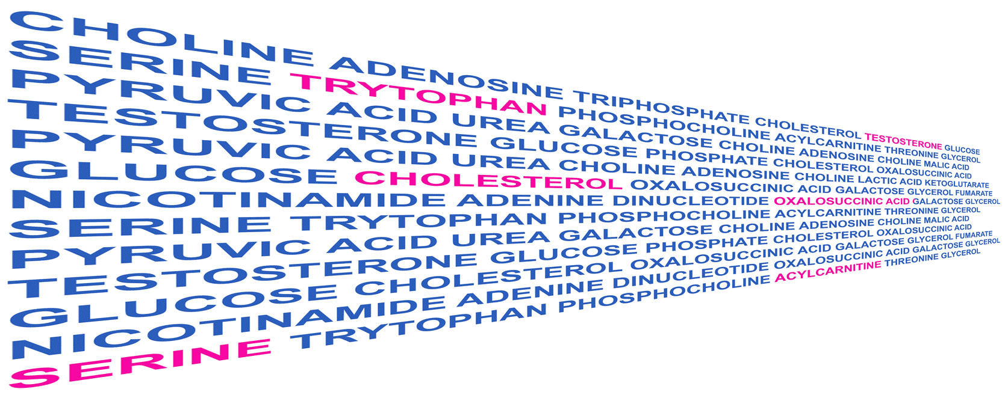

Background
For GUI software, most of them only support Windows,
Not flexible.
User-friendly,
Simple.
More tools are not listed here.
Notes:
From the step 1 analysis, we can know that exposome has…..

Slide 5
Background
For GUI software, most of them only support Windows,
Not flexible.
User-friendly,
Simple.
More tools are not listed here.
Notes:
From the step 1 analysis, we can know that exposome has…..

Slide 6
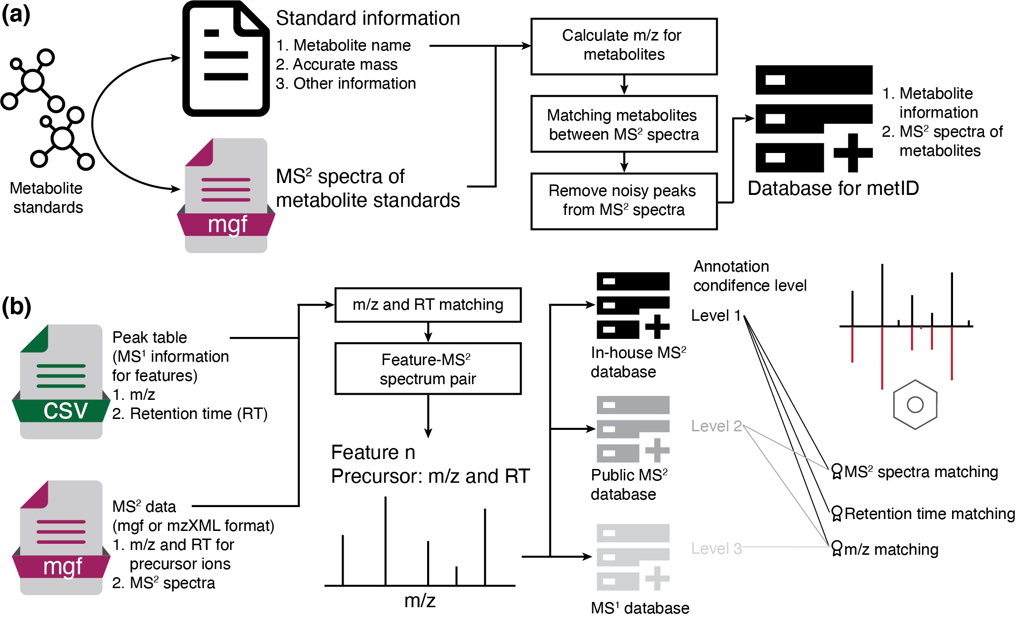
metID: Design and Overview
R-based: can be installed any platform (Windows, Mac and Linux).
Universal format database.
Support multiple database format from other common tools (GNPS, MoNA and so on).
Automatable metabolite annotation functions.
Xiaotao Shen et al. Bioinformatics, 2021.
Notes:
From the step 1 analysis, we can know that exposome has…..

Slide 7
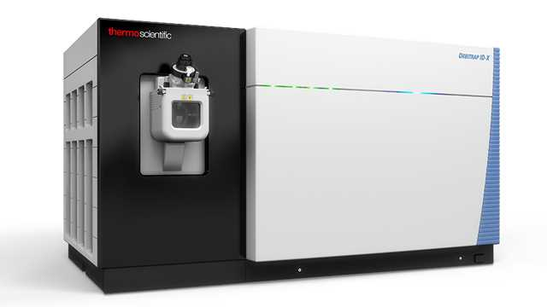
In-house Database Construction
A lot of labs have compound standard information (retention time and MS/MS spectra).
Metabolite information
Spectrum information
Database format for metID
Notes:
From the step 1 analysis, we can know that exposome has…..

Slide 8







Public Databases
Database format for metID
Notes:
From the step 1 analysis, we can know that exposome has…..

Slide 9
Public Databases
Example Code
Read databases from other tools
> massbank_database <-
> construct_mona_database(file = “MassBank.msp”,
source = ”MassBank")
> mona_database <-
construct_mona_database(file = “MoNA.msp”,
source = "MoNA")
> gnps_database <-
construct_gnps_database(file = “GNPS.msp”,
source = ”GNPS")
Output databases for other tools
> write_msp_mona(database = database, path = ".")
> write_msp_massbank(database = database, path = ".")
> write_msp_gnps(database = database, path = ".")
> write_mgf_mona(database = database, path = ".")
> write_mgf_massbank(database = database, path = ".")
> write_mgf_gnps(database = database, path = ".")
Notes:
From the step 1 analysis, we can know that exposome has…..

Slide 10

Databases Provided in metID
Database | Compound number | Spectrum number | Information | Level | Source
msDatabase_rplc0.0.2 | 917 | 2,047 | mz/RT/MS² | 1 | Snyder lab
msDatabase_hilic0.0.2 | 846 | 2,570 | mz/RT/MS² | 1 | Snyder lab
hmdbDatabase0.0.2 | 5,646 | 22,331 | mz/MS² | 2 | https://hmdb.ca/downloads
massbankDatabase0.0.2 | 18,311 | 91,148 | mz/MS² | 2 | https://massbank.eu/MassBank
monaDatabase0.0.2 | 19,537 | 40,315 | mz/MS² | 2 | https://mona.fiehnlab.ucdavis.edu
orbitrapDatabase0.0.1³ | 8,360 | 23,227 | mz/MS² | 2 | https://mona.fiehnlab.ucdavis.edu
fiehn_hilic_database0.0.1 | 3,042 | 3,042 | mz/MS² | 2 | https://fiehnlab.ucdavis.edu/staff/kind/publications
Notes:
From the step 1 analysis, we can know that exposome has…..

Slide 11
Databases Provided in metID
Database | Compound number | Spectrum number | Information | Level | Source
hmdbMS1Database0.0.1 | 114,004 | 0 | mz | 3 | https://hmdb.ca/downloads
keggMS1Database_1.0 | 16,409 | 0 | mz | 3 | https://www.genome.jp/kegg/compound/
drugbankMS1Database5.1.8 | 11,174 | 0 | mz | 3 | https://go.drugbank.com/releases/latest
T3DBMS1Database_1.0 | 3,533 | 0 | mz | 3 | http://www.t3db.ca/downloads
bloodExposomeMS1Database_1.0 | 65,957 | 0 | mz | 3 | https://bloodexposome.org/#/download
Notes:
From the step 1 analysis, we can know that exposome has…..

Slide 12
Databases Provided in metID
Database | Compound number | Spectrum number | Information | Level | Source
hmdbMS1Database0.0.1 | 114,004 | 0 | mz | 3 | https://hmdb.ca/downloads
keggMS1Database_1.0 | 16,409 | 0 | mz | 3 | https://www.genome.jp/kegg/compound/
drugbankMS1Database5.1.8 | 11,174 | 0 | mz | 3 | https://go.drugbank.com/releases/latest
T3DBMS1Database_1.0 | 3,533 | 0 | mz | 3 | http://www.t3db.ca/downloads
bloodExposomeMS1Database_1.0 | 65,957 | 0 | mz | 3 | https://bloodexposome.org/#/download
54,896 compound and 180,063 spectra in total
(Only the databases with MS/MS spectra)
Notes:
From the step 1 analysis, we can know that exposome has…..

Slide 13
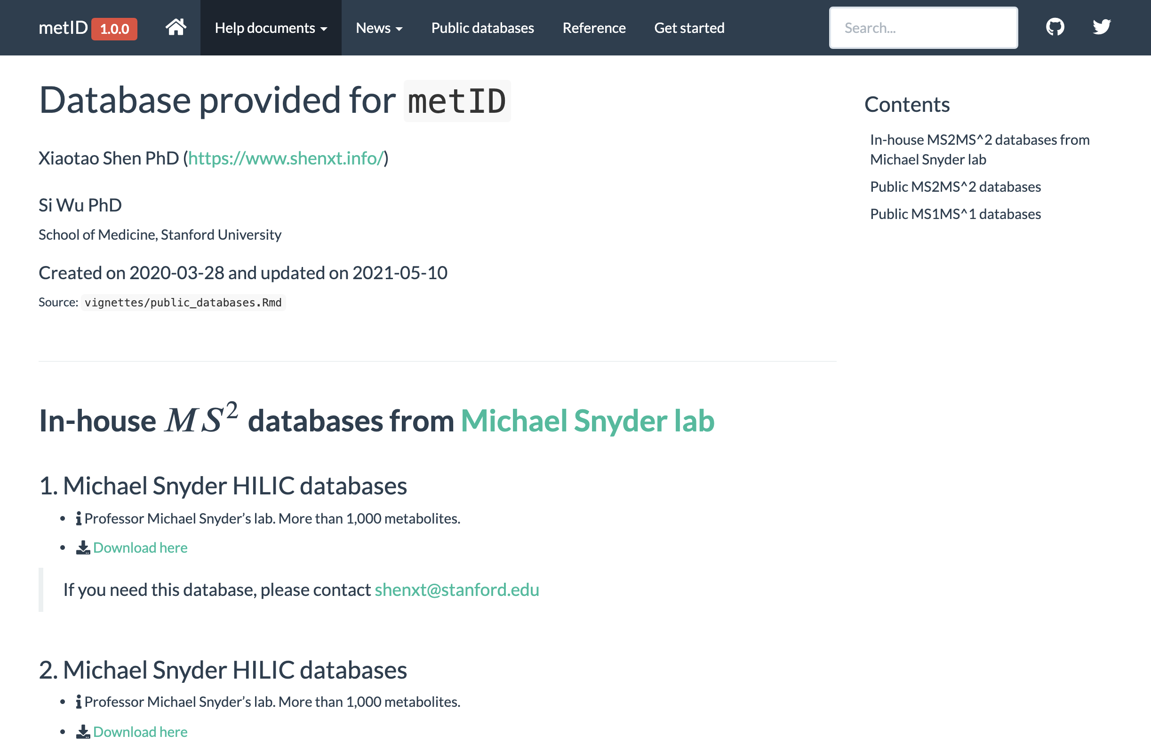
Database Sharing
Notes:
From the step 1 analysis, we can know that exposome has…..

Slide 14
Automatable Metabolite annotation
Example Code
> param1 <-
identify_metabolites_params(ms1.match.ppm = 15, rt.match.tol = 15, polarity = "positive", ce = "all", column = "rp",
total.score.tol = 0.5, candidate.num = 3, threads = 3, database = "msDatabase_rplc0.0.2" )
> param2 <-
identify_metabolites_params(ms1.match.ppm = 15, rt.match.tol = 15, polarity = “positive”, ce = “all”, column = “rp”,
total.score.tol = 0.5, candidate.num = 3, threads = 3, database = ”MoNA")
> result <-
identify_metabolite_all(ms1.data = “ms1.peak.table.csv”,
ms2.data = “QC1_MSMS_NCE25.mgf”,
parameter.list = c(param1, param2))
result[[1]]
#> --------------metID version-----------
#> 0.4.1
#> -----------Identifications------------
#> (Use get_identification_table() to get identification table)
#> There are 100 peaks
#> 23 peaks have MS2 spectra
#> There are 14 metabolites are identified
#> There are 10 peaks with identification
#> -----------Parameters------------
#> (Use get_parameters() to get all the parameters of this processing)
#> Polarity: positive
#> Collision energy: all
#> database: msDatabase_rplc0.0.2
#> Total score cutoff: 0.5 #> Column: rp
#> Adduct table: #> (M+H)+;(M+H-H2O)+;(M+H-2H2O)+
Notes:
From the step 1 analysis, we can know that exposome has…..

Slide 15
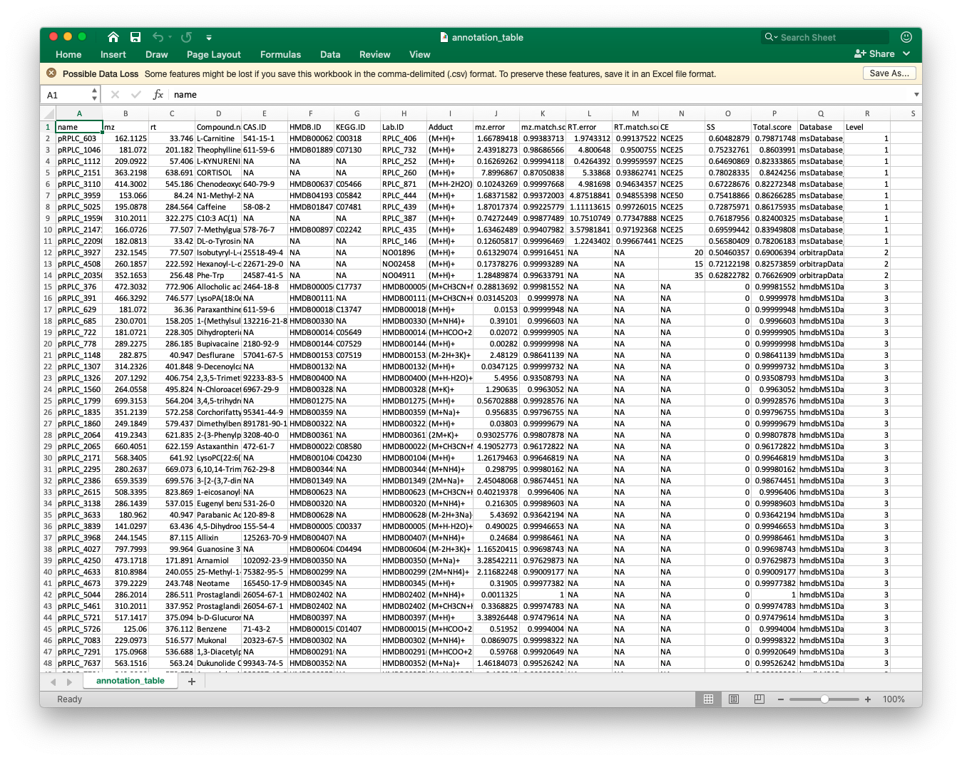
Automatable Metabolite annotation
Notes:
From the step 1 analysis, we can know that exposome has…..

Slide 16
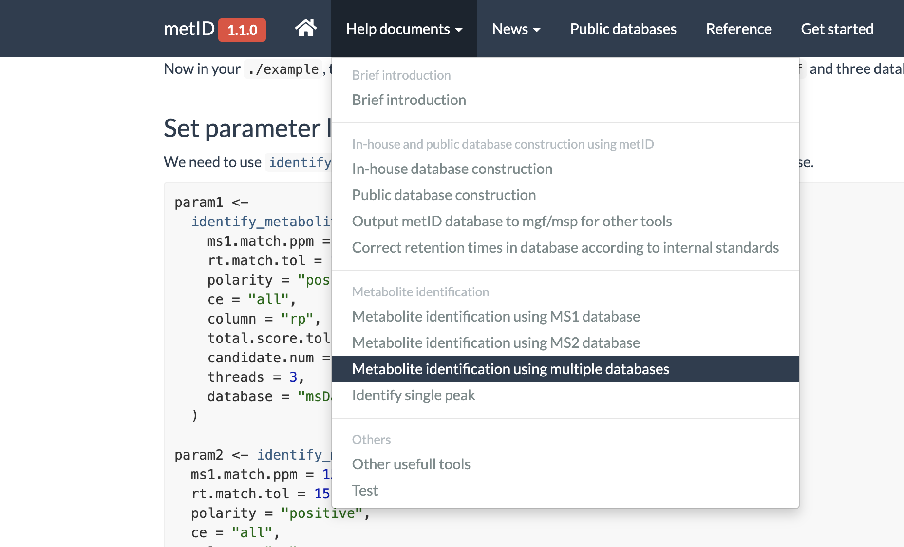
Other functions from metID and website of metID
https://jaspershen.github.io/metID/
Notes:
From the step 1 analysis, we can know that exposome has…..

Slide 17
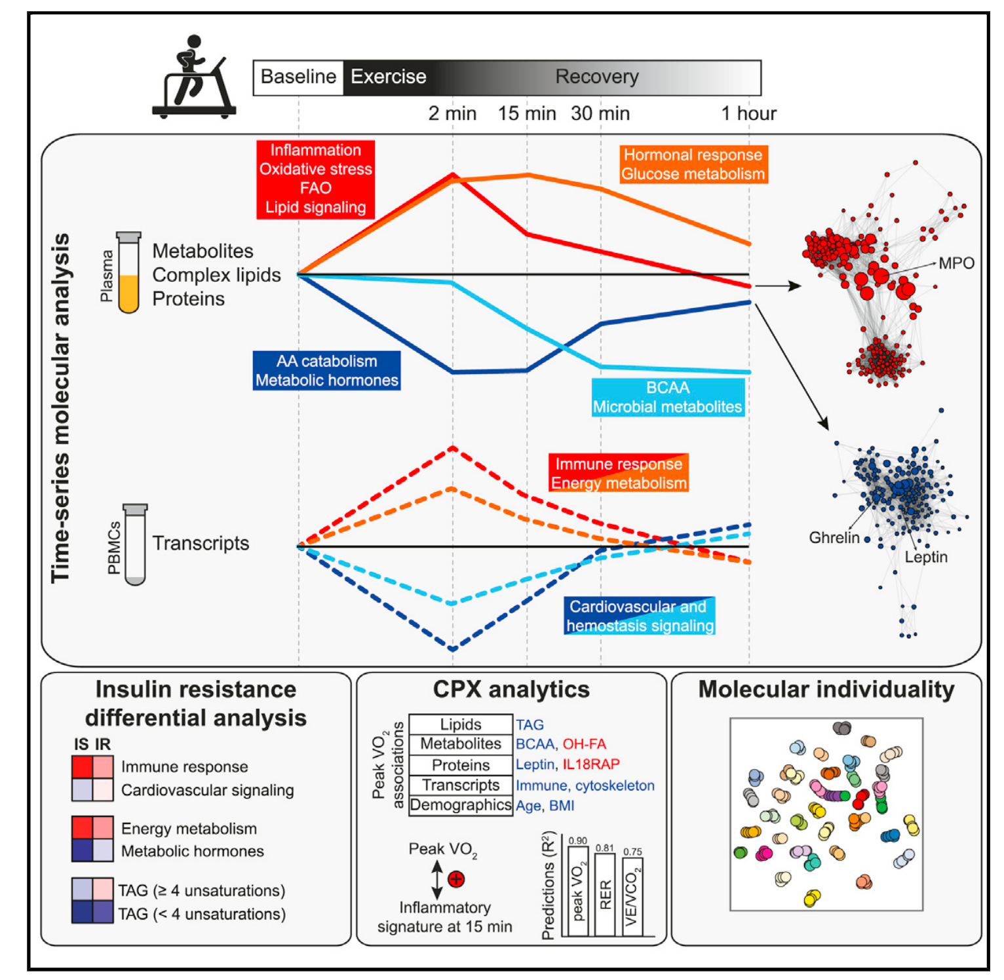
Case Study
Variable | Information
Sample type | Plasma
Subject sample number | 310
QC sample number | 36
Data acquisition | Untargeted metabolomics
Instrument platform | LC-MS
Chromatographic condition | RPLC + HILIC
Polarity mode | Positive + negative
463 manually annotate metabolites.
(Golden standard)
﻿Contrepois et al. Cell, 2020.
Notes:
From the step 1 analysis, we can know that exposome has…..

Slide 18
Case Study
Same dataset processed by metID
We retrieved all the 463 metabolites annotated in the original paper.
457 out of 463 annotation are consistent with exercise paper.
We additionally annotate 479 more metabolites.
479
metabolites
463 metabolites
Notes:
From the step 1 analysis, we can know that exposome has…..

Slide 19
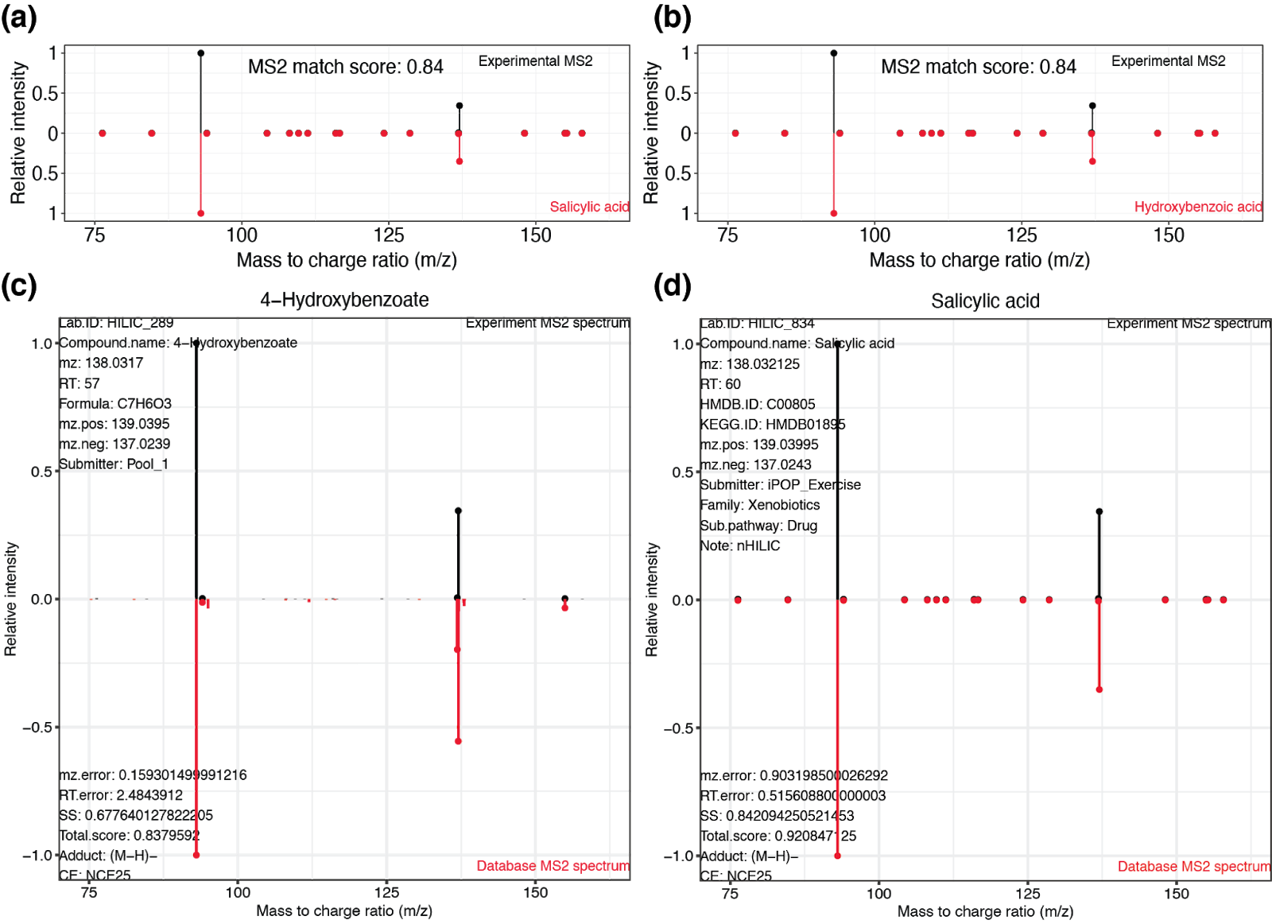
Non-consistent Annotations
peak 1.00_137.0243m/z
For metID, rank 2 annotation is consistent with the original paper annotation.
Notes:
From the step 1 analysis, we can know that exposome has…..

Slide 20
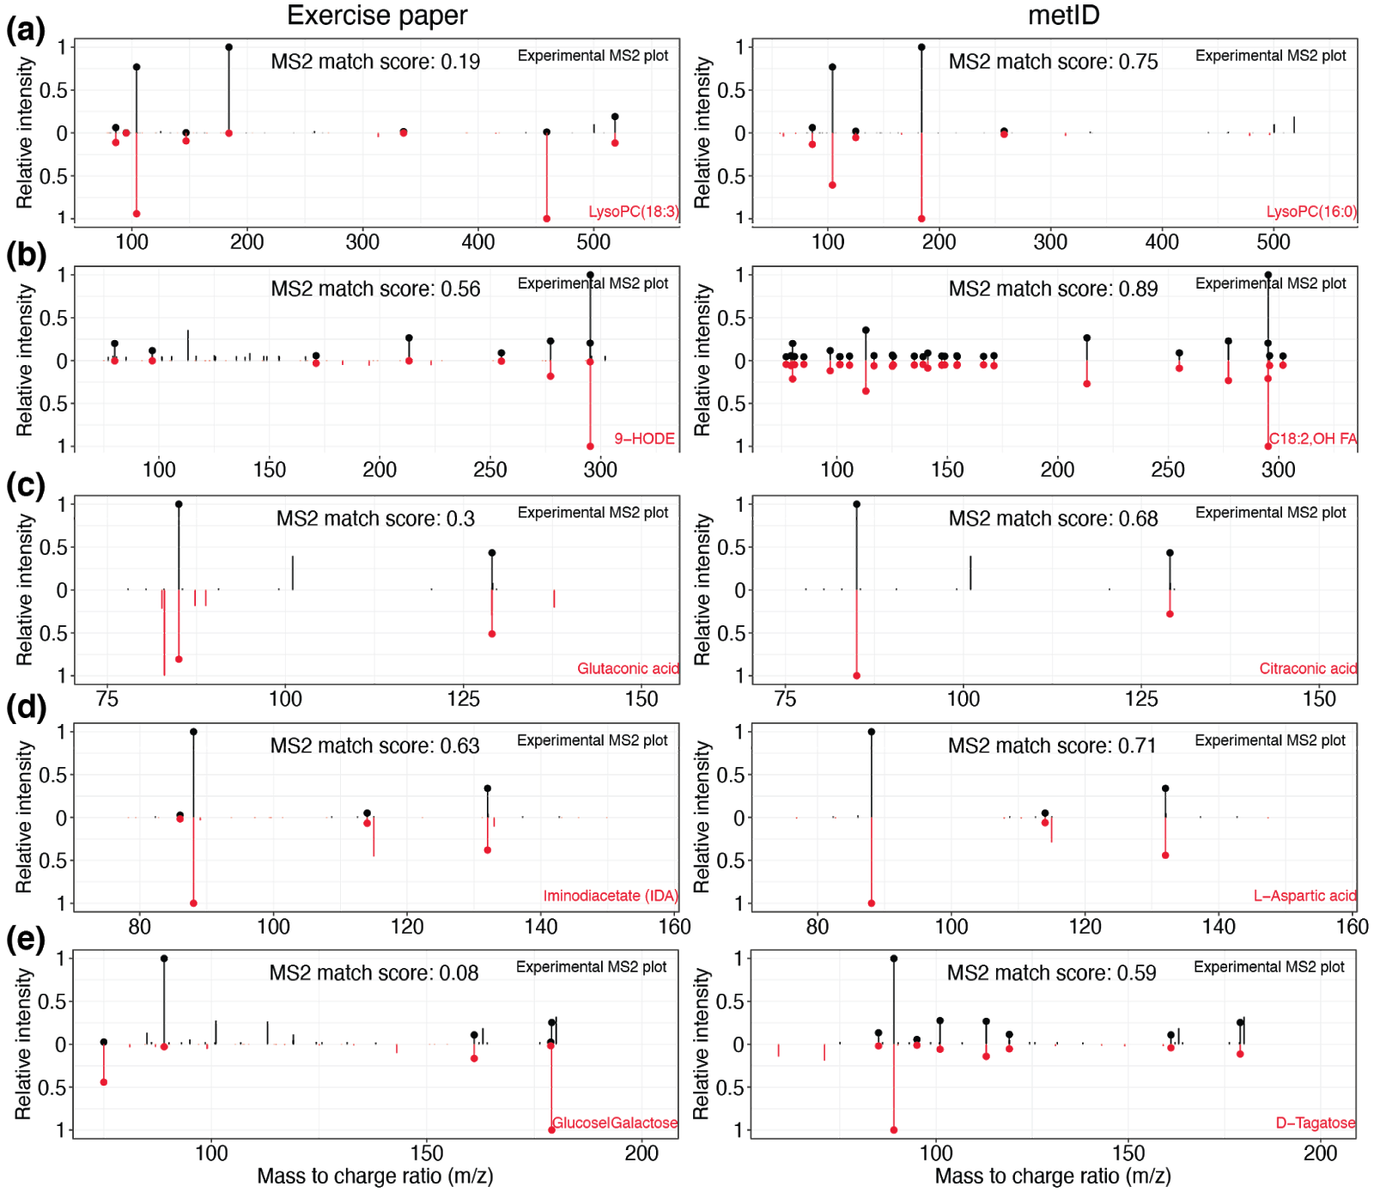
Non-consistent Annotations
For the other five metabolites with the inconsistency of annotation, we found that the annotation by metID has higher MS/MS scores than the annotation in the original paper, indicating metID has high annotation accuracy.
Notes:
From the step 1 analysis, we can know that exposome has…..

Slide 21
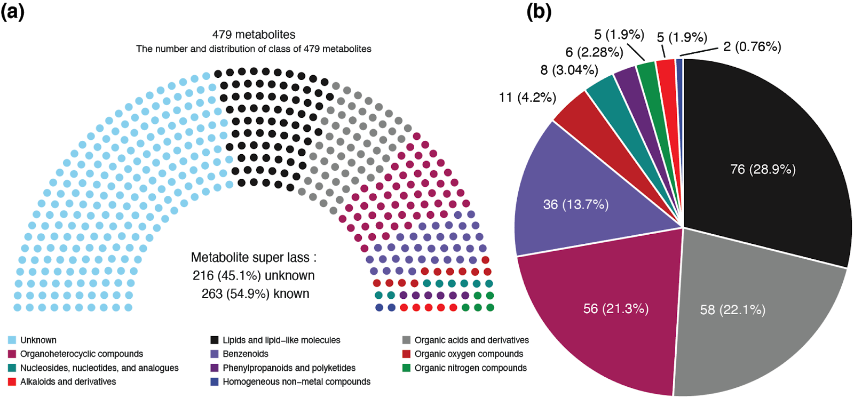
479 More Metabolites
Notes:
From the step 1 analysis, we can know that exposome has…..

Slide 22
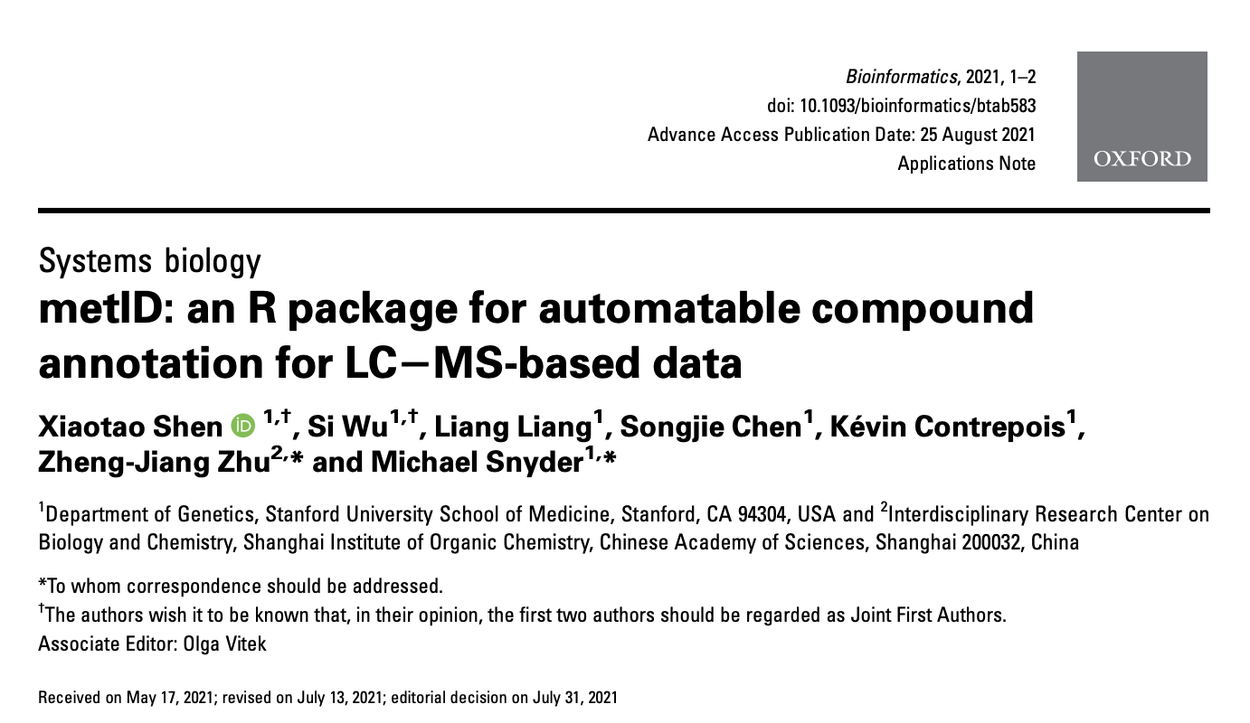
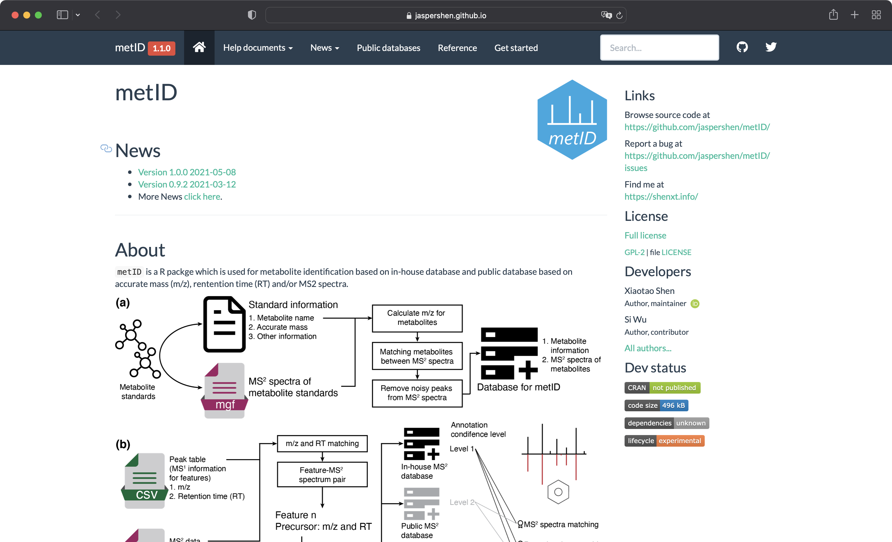
Summary
In-house database construction.
Automatable compound annotation.
Flexible to connect with other tools.
Easy to add new method/algorithms.
https://jaspershen.github.io/tidymass/
Notes:
From the step 1 analysis, we can know that exposome has…..

Slide 23
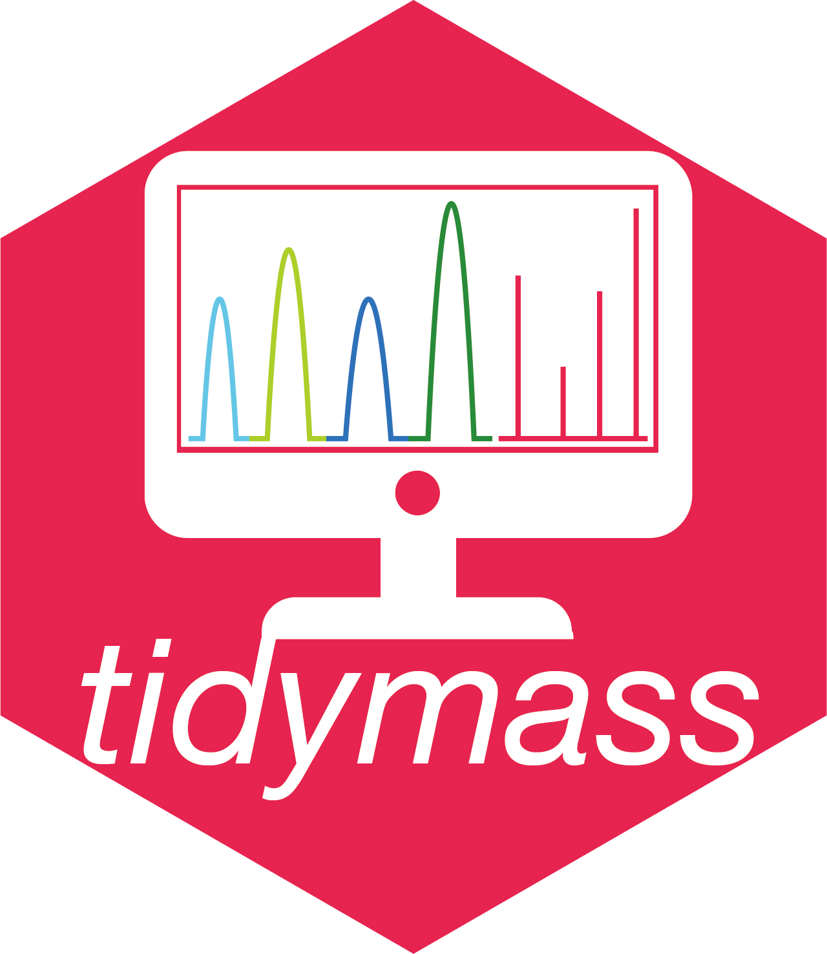
TidyMass: A Computational Framework for LC-MS Data processing and analysis

Slide 24
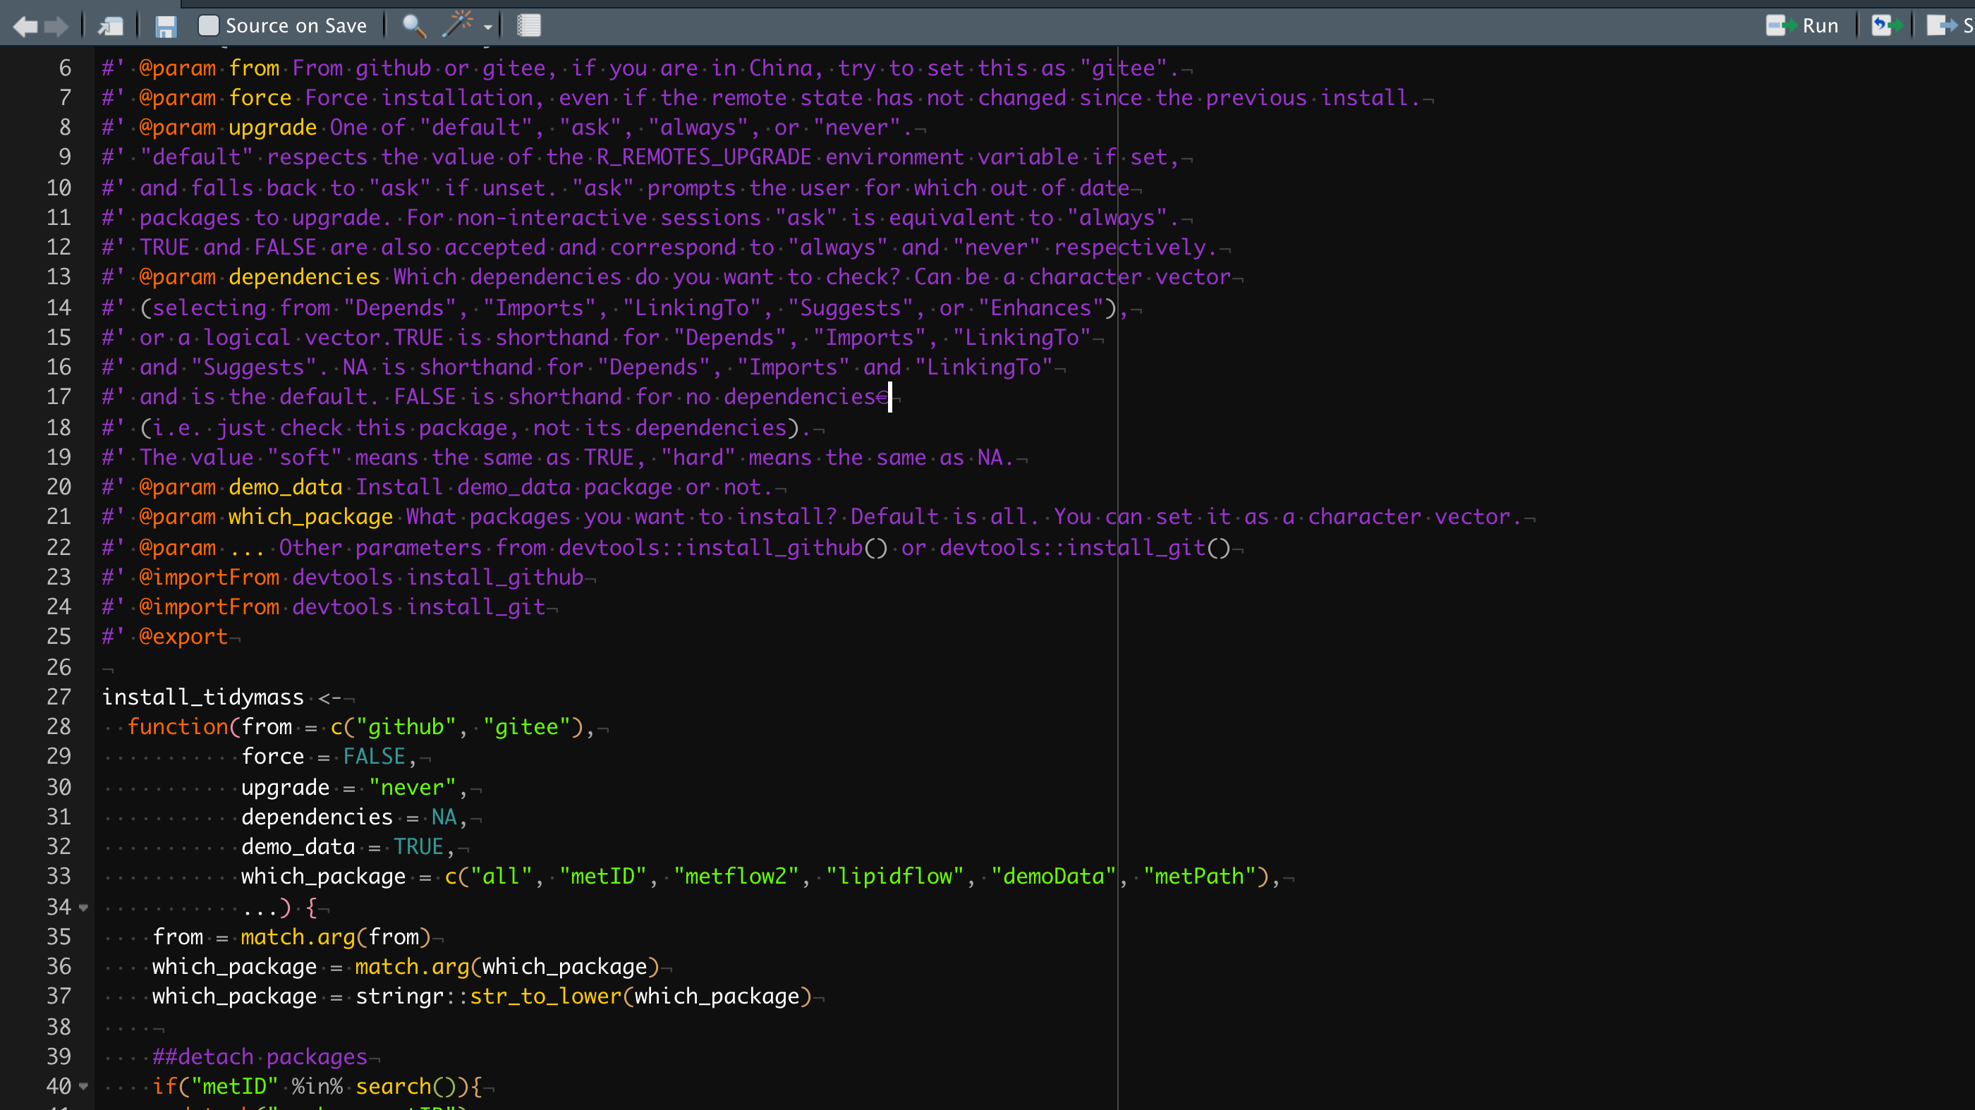




R is the most important language for bioinformatics analysis
Bioconductor
Comprehensive R Archive Network (CRAN)
GitHub
R-Forge
2,083 packages
(10/31/2021)
18,357 packages
(10/31/2021)
34,268 active repos
(10/1/2014)
2,148 packages
(10/31/2021)

Slide 25






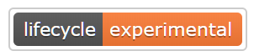

TidyMass: Collection of R Packages for Mass Spectrometry Data Analysis
metflow2: Raw MS data processing and data cleaning
https://jaspershen.github.io/metflow2/
metNormalizer: Data normalization and integration
https://jaspershen.github.io/MetNormalizer/
metID: Compound identification
https://jaspershen.github.io/metID/
metPath: Biological information mining
https://jaspershen.github.io/metPath/
lipidflow: Lipidomics data analysis. (Chuchu Wang)
https://jaspershen.github.io/lipidflow/
fMSEA: feature based metabolite set enrichment analysis
https://jaspershen.github.io/fMSEA/
tinyTools: Toolkit for MS data processing.
https://jaspershen.github.io/tinyTools/

Slide 26
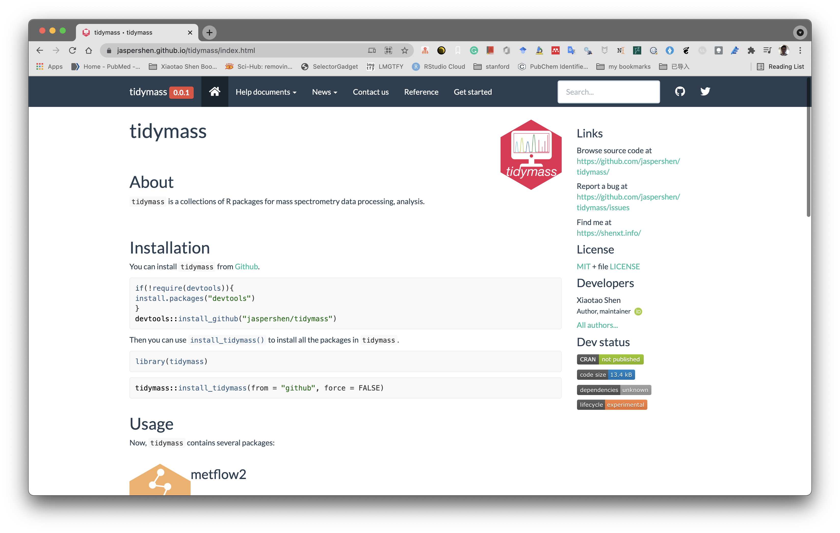
TidyMass: Collection of R Packages for Mass Spectrometry Data Analysis
https://jaspershen.github.io/tidymass/

Slide 27
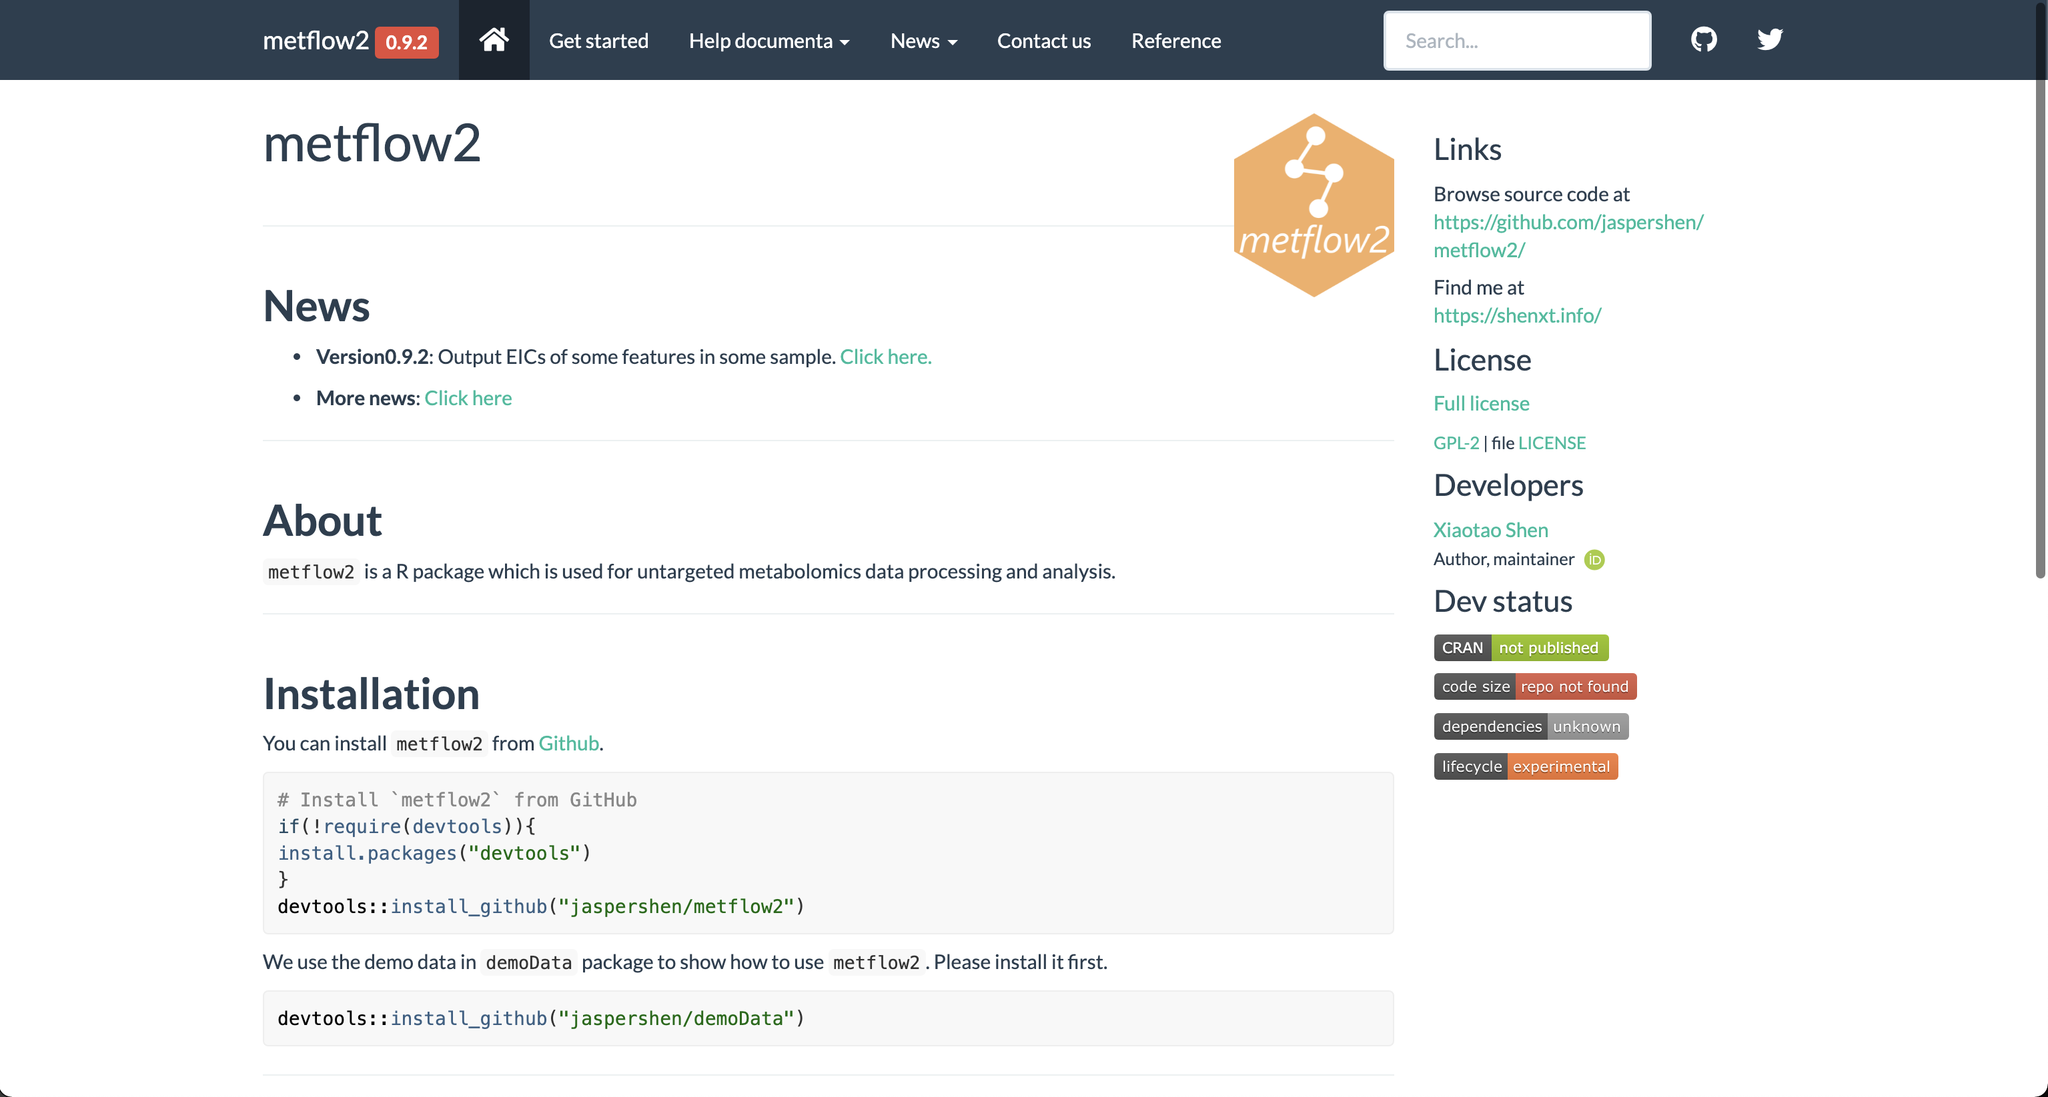
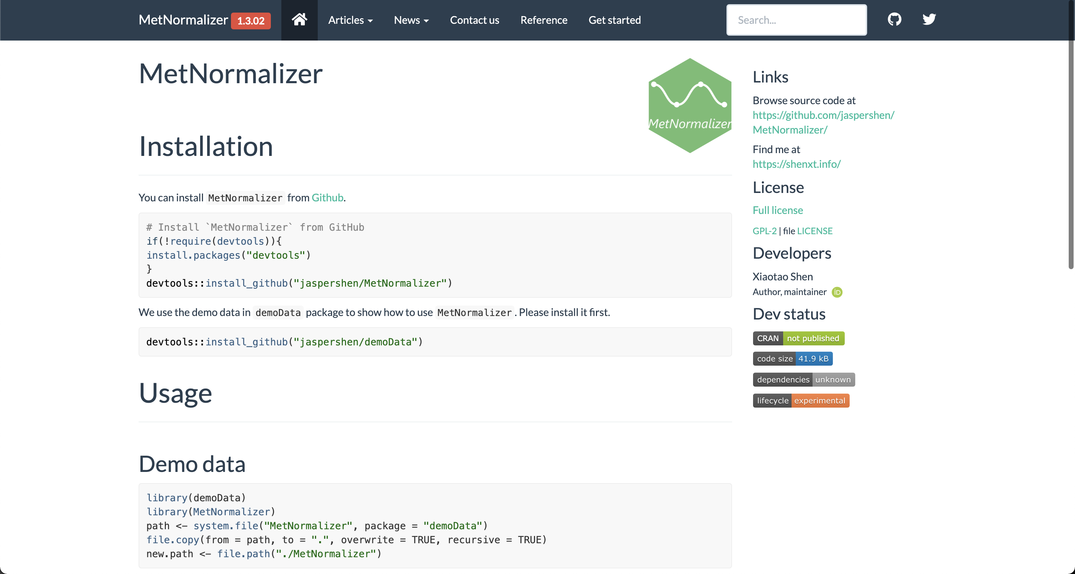
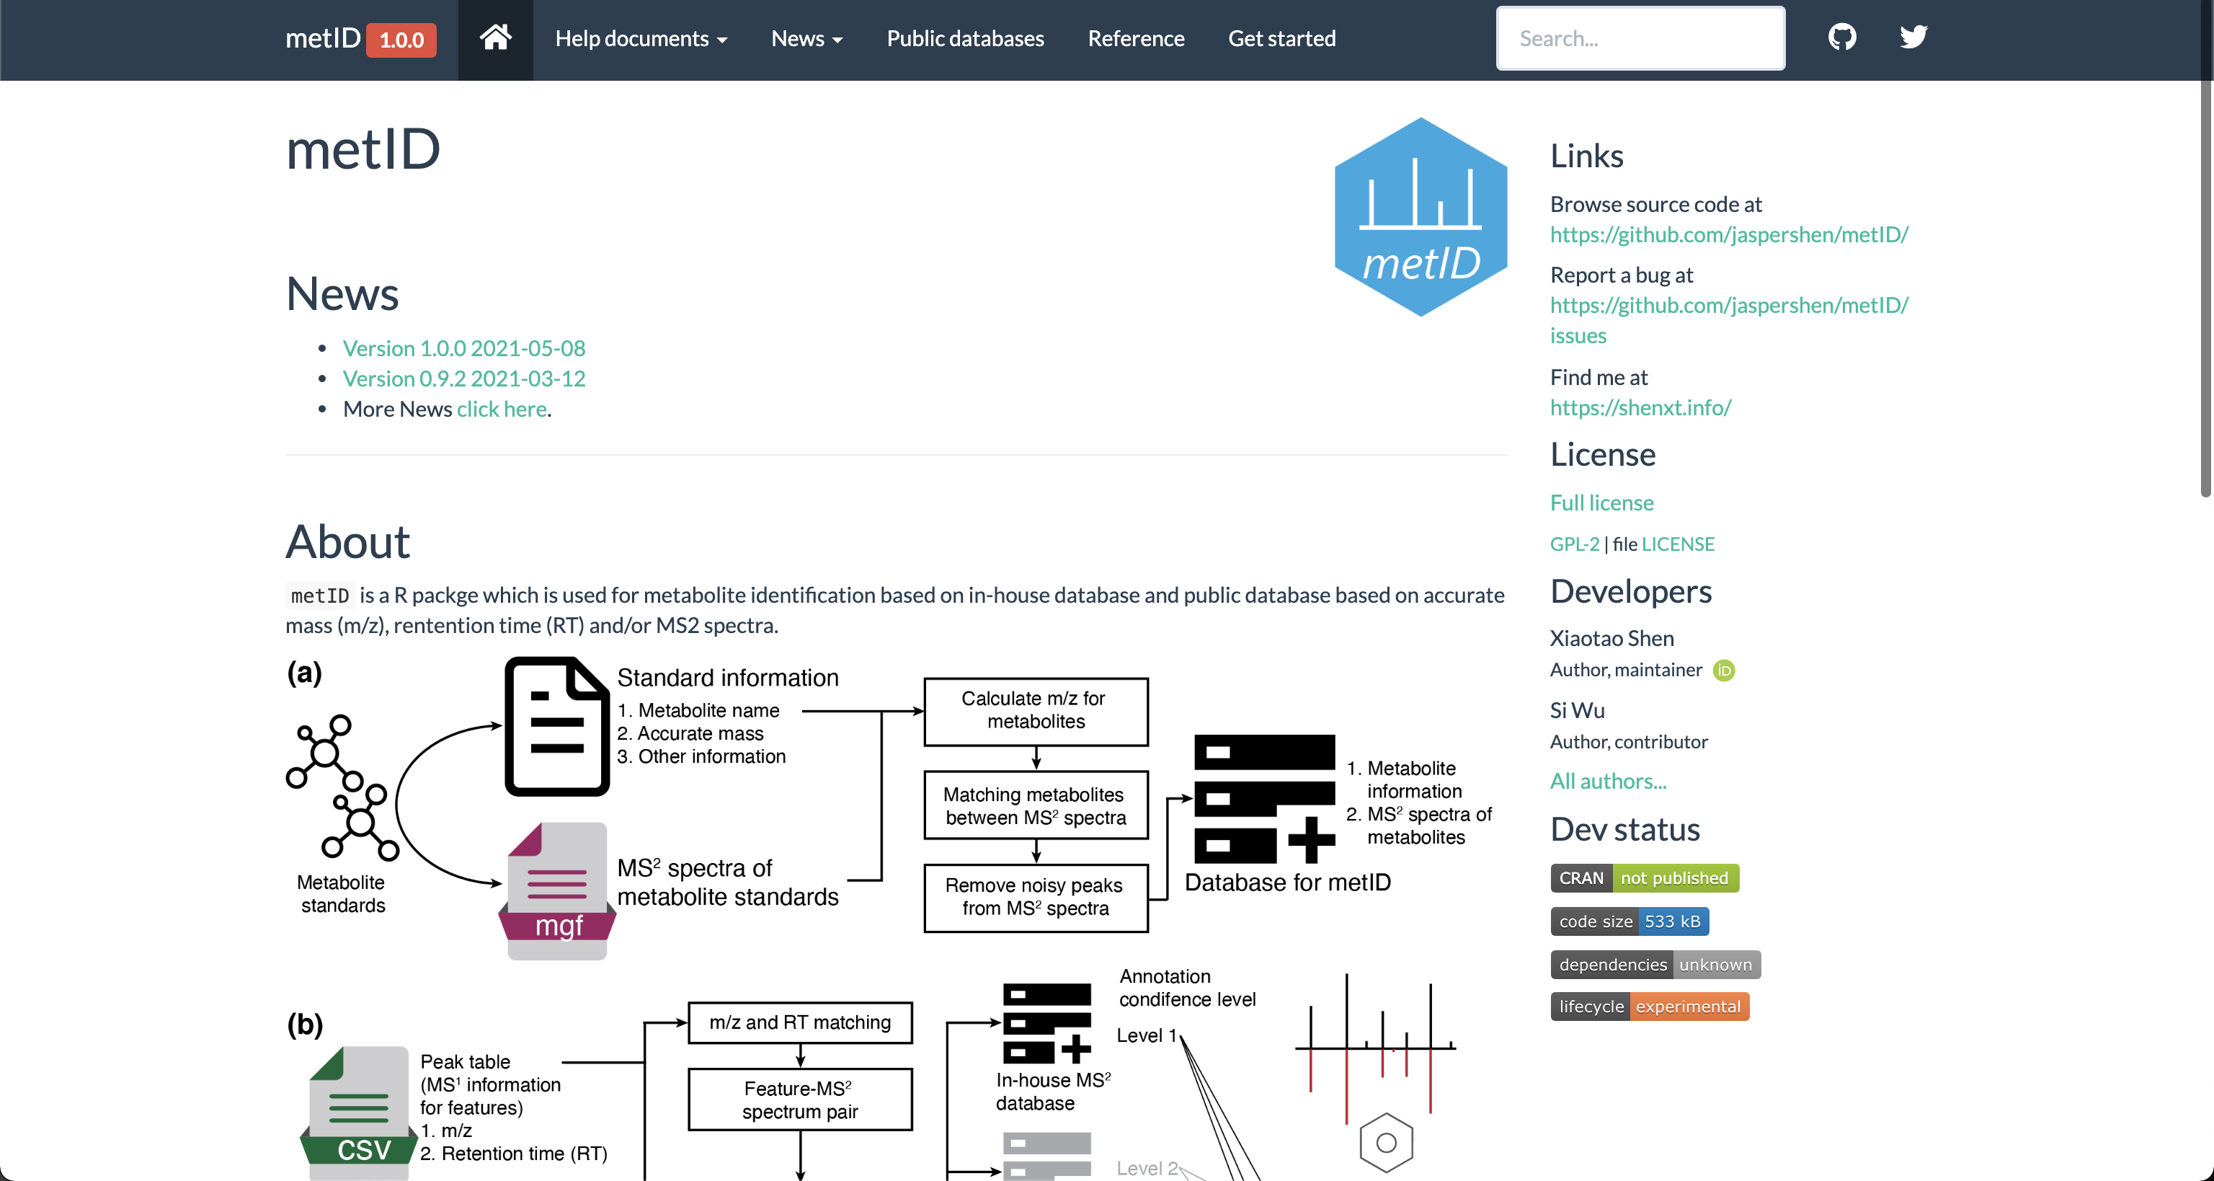
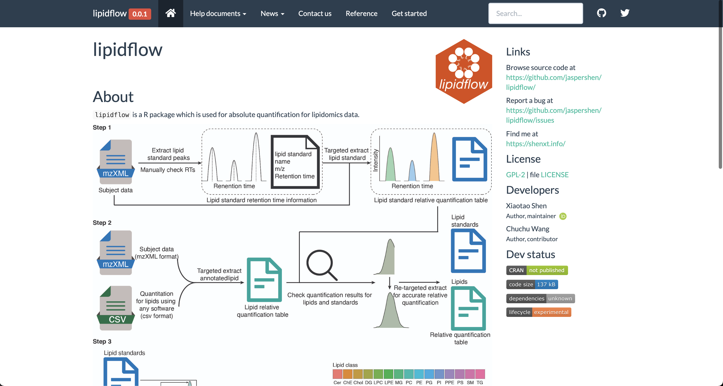
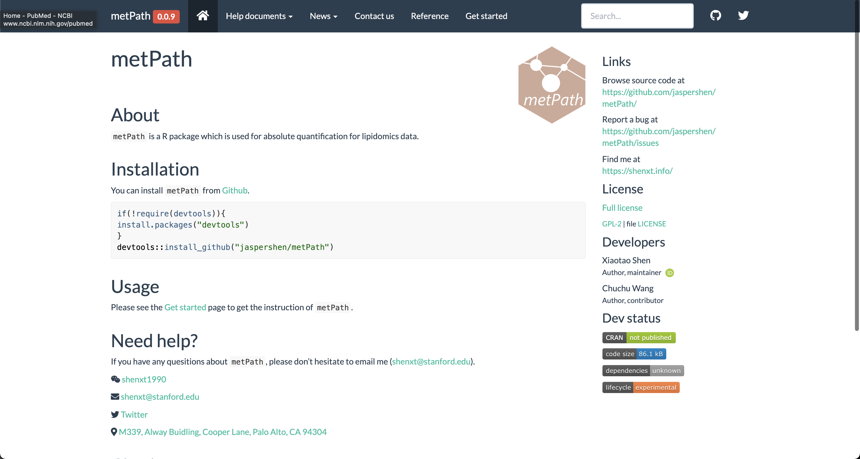
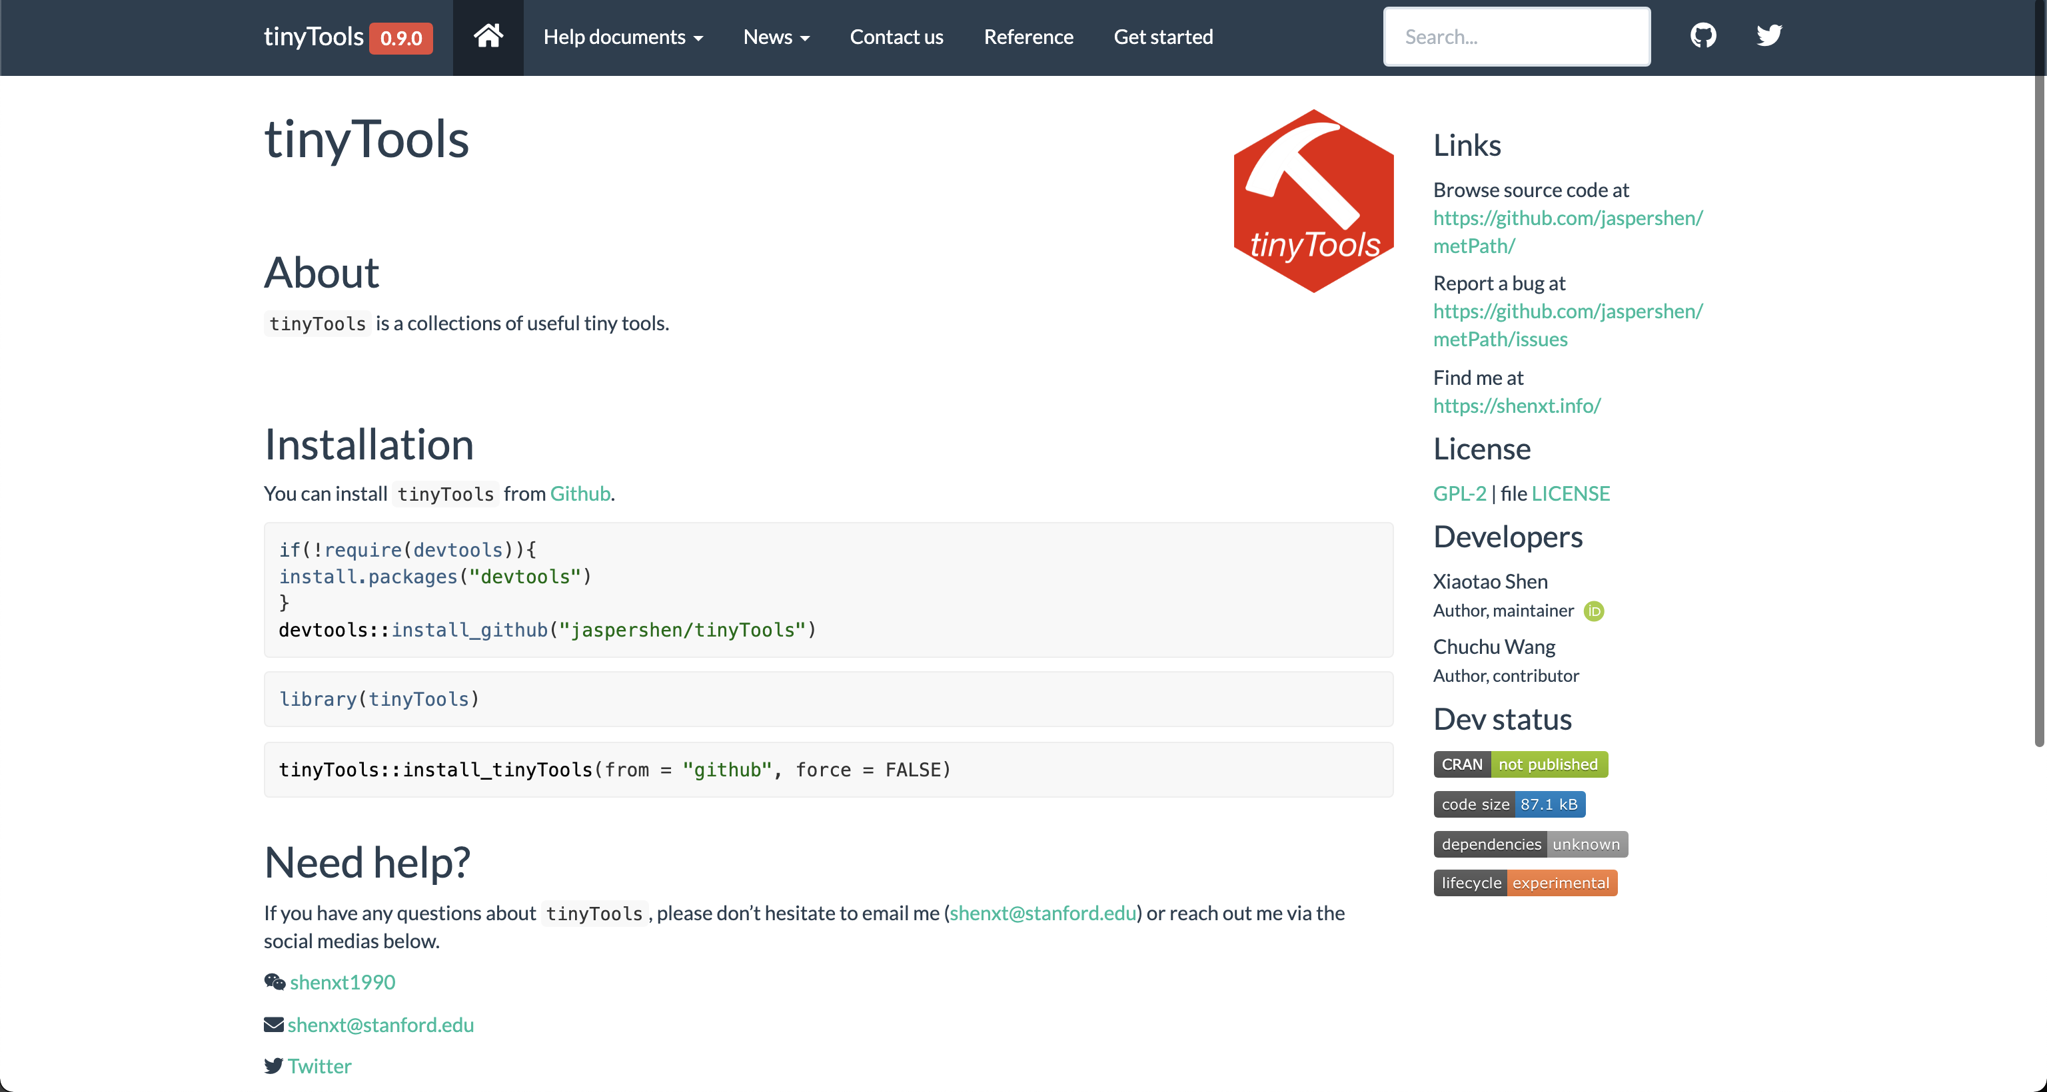
TidyMass: Collection of R Packages for Mass Spectrometry Data Analysis
https://jaspershen.github.io/tidymass/

Slide 28


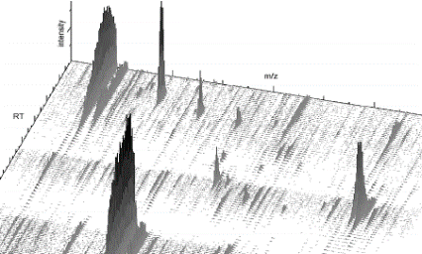


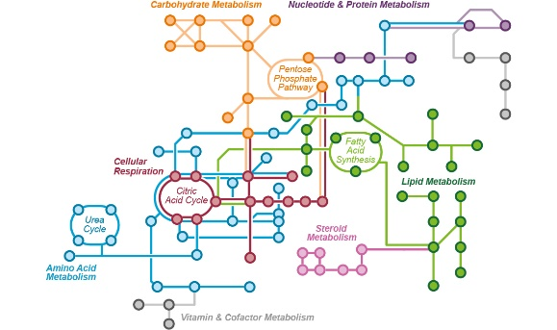
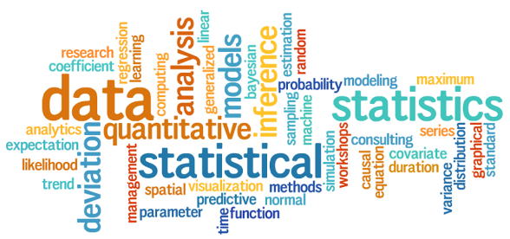
Workflow of LC-MS Data Processing and Analysis
MS raw data
Data processing
Peak table
Data Cleaning
Compound identification
Statistical analysis
Biological interpretation

Slide 29

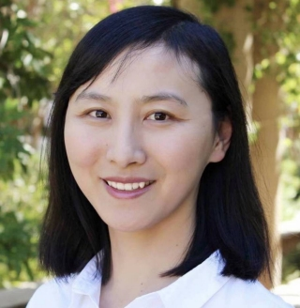


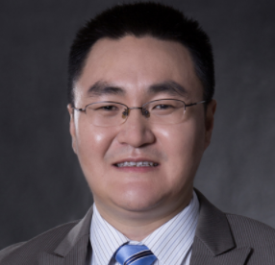
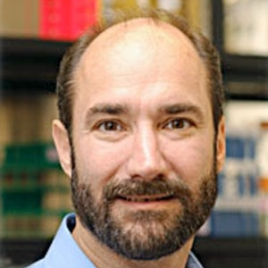
ACKNOWLEDGEMENTS
Dr. Si Wu
(Stanford University)
Dr. Liang Liang
(Stanford University)
Dr. Songjie Chen
(Stanford University)
Dr. Kévin Contrepois
(Stanford University)
Prof. Zheng-Jiang Zhu
(CAS)
Prof. Michael Snyder
(Stanford University)

Slide 30
Thanks for your attention!
Q&A
Xiaotao Shen PhD
Stanford School of Medicine
Department of Genetics
shenxt@stanford.edu
@xiaotaoshen1990
shenxt.me
github.com/jaspershen

